Slide 1
Branch and Bound

Slide 2
Introduction
In backtracking, we used depth-first search with pruning to traverse the (virtual) state space. We can achieve better performance for many problems using a breadth-first search with pruning. This approach is known as branch-and-bound
Branch and Bound is a general search method.
Starting by considering the root problem (the original problem with the complete feasible region), the lower bounding and upper-bounding procedures are applied to the root problem.
If the bounds match, then an optimal solution has been found and the procedure terminates.
Otherwise, the feasible region is divided into two or more regions, these subproblems partition the feasible region.

Slide 3
Introduction
The algorithm is applied recursively to the subproblems. If an optimal solution is found to a sub problem, it is a feasible solution to the full problem, but not necessarily globally optimal.
If the lower bound for a node exceeds the best known feasible solution, no globally optimal solution can exist in the subspace of the feasible region represented by the node. Therefore, the node can be removed from consideration.
The search proceeds until all nodes have been solved or pruned, or until some specified threshold is met between the best solution found and the lower bounds on all unsolved subproblems.

Slide 4
State Space Pruning
A search along a path is terminated if
The value of the node's bound is not better than the value of the best solution seen so far
Constraints of solution already violated, hence node represents no feasible solution
The subset of feasible solutions represented by the node consists of a single point (and hence no further choices can be made )

Slide 5
Branch and Bound - Examples
0-1 Knapsack problem
Can be solved by other approaches but Branch and Bound solves with a better complexity equivalent to dynamic programming
Travelling Salesman’s problem
N-Queens problem
Backtracking approach solves better than Branch and Bound
Branch and Bound best suits the combinatorial optimization problems (i.e.) optimization problems for which order of items picked doesn’t matter…

Slide 6
0-1 Knapsack Problem
Given two integer arrays val[0..n-1] and wt[0..n-1] that represent values and weights associated with n items respectively. Find out the maximum value subset of val[] such that sum of the weights of this subset is smaller than or equal to Knapsack capacity W.
A Greedy approach is to pick the items in decreasing order of value per unit weight. The Greedy approach works only for fractional knapsack problem and may not produce correct result for 0/1 knapsack.
We can use Dynamic Programming (DP) for 0/1 Knapsack problem. In DP, we use a 2D table of size n x W. The DP Solution doesn’t work if item weights are not integers.
Since DP solution doesn’t always work, a solution is to use Brute Force. With n items, there are 2^{n} solutions to be generated, check each to see if they satisfy the constraint, save maximum solution that satisfies constraint.
We can use Backtracking to optimize the Brute Force solution. We can do better (than backtracking) if we know a bound on best possible solution subtree rooted with every node. So we compute bound (best solution) for every node and compare the bound with current best solution before exploring the node.

Slide 7
0-1 Knapsack – Branch and Bound
At each node, record the following
total weight w of the selection
the total value v of this selection
Upper bound b
b = v + ( W – w) (v_{i+1} /w_{i+1})
v is the total value of items already selected
W-w is the remaining capacity of knapsack
v_{i+1} /w_{i+1} is the best per unit payoff among the remaining items

Slide 8
Example 1
Solve the given 0-1 knapsack problem using branch and bound method. Capacity of the knapsack is 10.
Solution:
Step 1: Calculate the upper and the lower bound
Step 2: Calculate the value index and sort the itemset in descending order based on value index
Step 3: Construct the state space tree using the approach
Item | Weight | Value
1 | 4 | 40
2 | 7 | 42
3 | 5 | 25
4 | 3 | 12

Slide 9
Example 1
already sorted
Calculate the value index and sort in descending order
Upper bound:
v=0, W=10, w=0
b=0+(10-0)(10)=100
Item | Weight | Value
1 | 4 | 40
2 | 7 | 42
3 | 5 | 25
4 | 3 | 12
Item | Weight | Value | Value Index
1 | 4 | 40 | 10
2 | 7 | 42 | 6
3 | 5 | 25 | 5
4 | 3 | 12 | 4
Upper bound b
b = v + ( W – w) (v_{i+1} /w_{i+1})
v is the total value of items already selected
W-w is the remaining capacity of knapsack
v_{i+1} /w_{i+1} is the best per unit payoff among the remaining items

Slide 10
Example 1
w=0, v=0
b=100
b = v + ( W – w) (v_{i+1} /w_{i+1})
without Item 1
with Item 1
without Item 1
with Item 1
Item | w | v | VI
1 | 4 | 40 | 10
2 | 7 | 42 | 6
3 | 5 | 25 | 5
4 | 3 | 12 | 4
w=0, v=0
b=0+(10-0)*6 = 60
w=4, v=40
b=40+(10-4)*6 = 76
with Item 2
without Item 2
w=11 exceeds the capacity. Not promising..
w=4, v=40
b=40+(10-4)*5 = 70
with Item 3
without Item 3
w=9, v=65
b=65+(10-9)*4 = 69
w=4, v=40
b=40+(10-4)*4 = 64
with Item 4
without Item 4
Final Solution (as item list is empty):
Profit= 65
Items picked = I1, I3
w=12 exceeds the capacity. Not promising..
w=9, v=65
b=65+(10-9)*0 = 65

Slide 11
Example 2
A thief enters a house for robbing it. He can carry a maximal weight of 25 kg into his bag. There are 4 items in the house with the following weights and values. What items should thief take if he either takes the item completely or leaves it completely?
Item | Weight (KG) | Value ($)
1 | 24 | 24
2 | 10 | 18
3 | 10 | 18
4 | 7 | 10
Item | Weight (KG) | Value ($) | Value Index
1 | 24 | 24 | 1
2 | 10 | 18 | 1.8
3 | 10 | 18 | 1.8
4 | 7 | 10 | 1.4

Slide 12
Example 2
w=0, v=0
b=45
b = v + ( W – w) (v_{i+1} /w_{i+1})
with Item 2
without Item 2
W= 25
w=10, v=18
b=18+(25-10)*1.8 = 45
w=0, v=0
b=0+(25-0)*1.8 = 45
Item | w | v | VI
2 | 10 | 18 | 1.8
3 | 10 | 18 | 1.8
4 | 7 | 10 | 1.4
1 | 24 | 24 | 1
with Item 3
without Item 3
without Item 3
w=20, v=36
b=36+(25-20)*1.4 = 43
w=10, v=18
b=18+(25-10)*1.4 = 39
with Item 3
with Item 4
without Item 4
w=10, v=18
b=18+(25-10)*1.4 = 39
w=0, v=0
b=0+(25-0)*1.4 = 35
w=27, exceeds sack capacity
w=20, v=36
b=36+(25-20)*1 = 41
Sorted based on Value Index
with Item 1
without Item 1
w=20, v=36
b=36+(25-20)*0 = 36
w=44, exceeds sack capacity

Slide 13
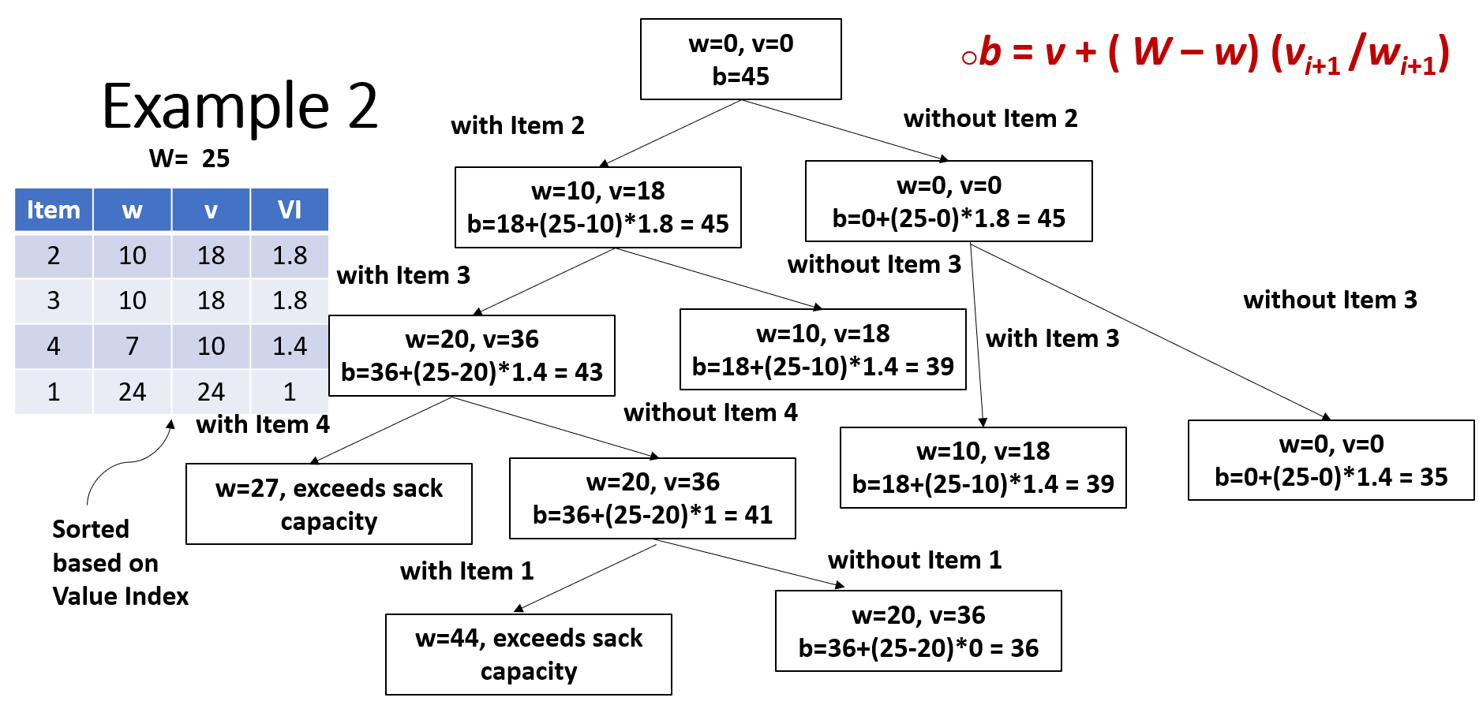
Example 2 --contd
with Item 4
without Item 4
without Item 4
with Item 4
w=17, v=28
b=28+(25-17)*1 = 36
w=10, v=18
b=18+(25-10)*1 = 33
w=17, v=28
b=28+(25-17)*1 = 36
w=10, v=18
b=18+(25-10)*1 = 33
with Item 1
without Item 1
with Item 1
without Item 1
w=41, exceeds the sack capacity
w=17, v=28
b=28+(25-17)*0 = 28
w=41, exceeds the sack capacity
w=17, v=28
b=28+(25-17)*0 = 28

Slide 14
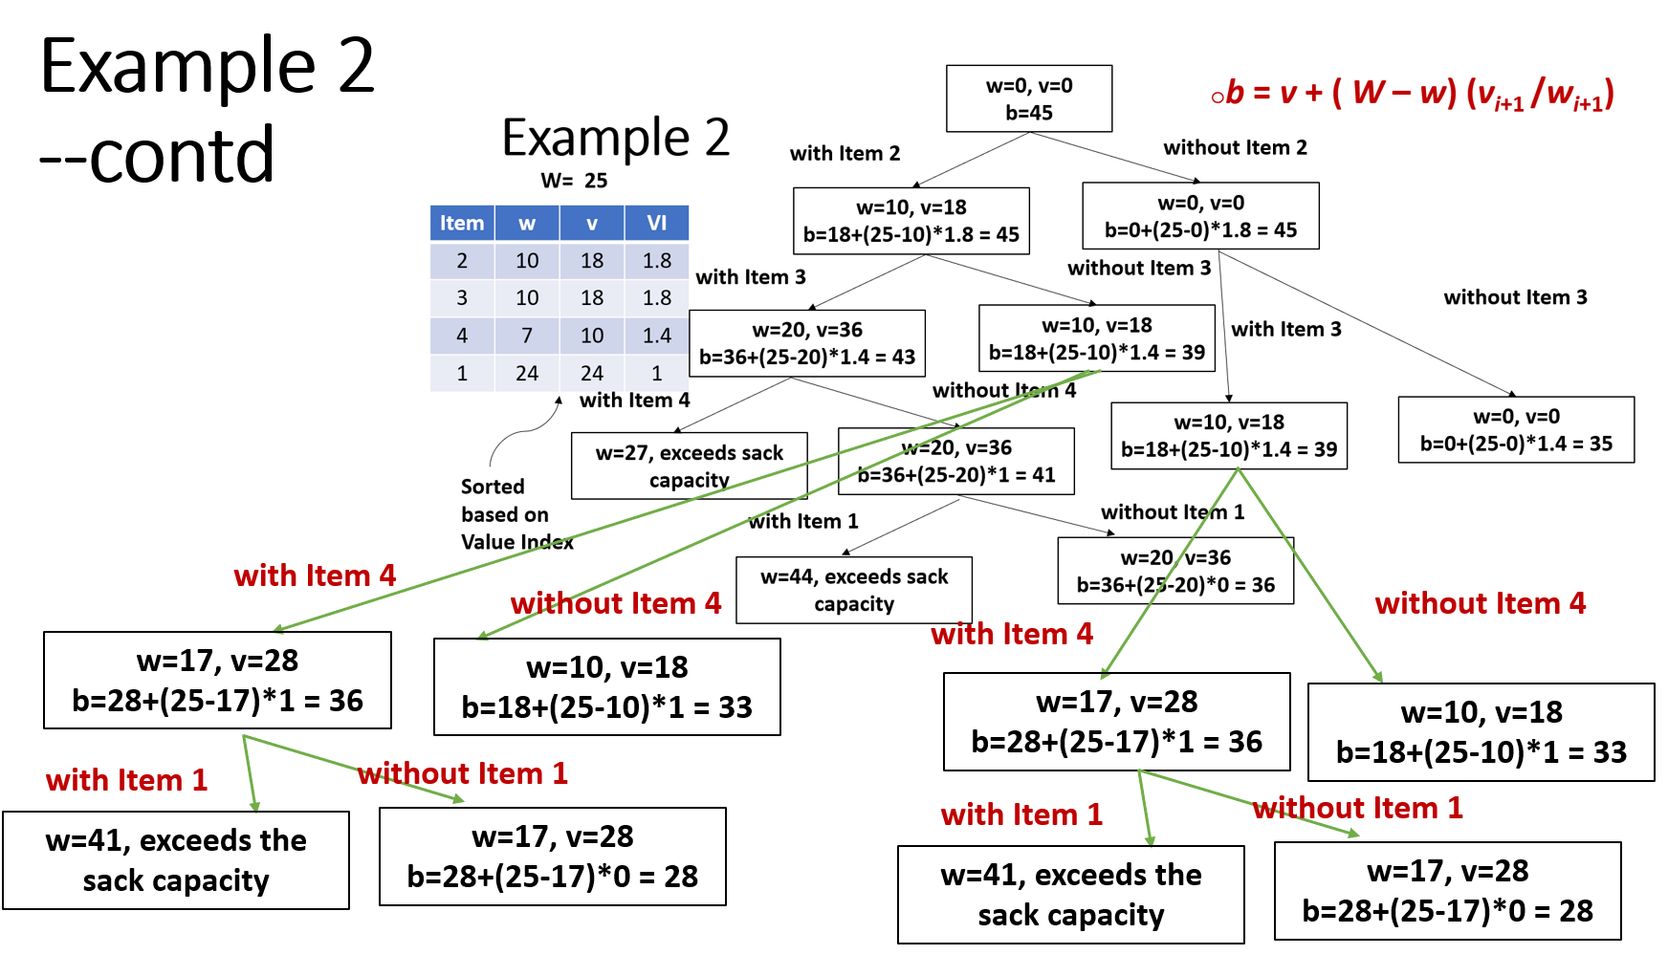
Cannot expand further as it is not an optimized solution
Cannot expand further as it is not an optimized solution
Cannot expand further because all items have been checked
Cannot expand further as it is not an optimized solution
Final Solution
Profit=36
Items picked=I2, I3
Cannot expand further because all items have been checked and not an optimized solution

Slide 15
Example 3
Try this as an assignment
Listed below are some semi-precious stones available for one to pick up. Solve the problem using the Branch and Bound approach, such that the knapsack has a profit limit over the chosen objects to be no more than 6, and you are to fill the knapsack with maximum possible total weight. You are not allowed to break any object. Show your work.
Object Id. | 1 | 2 | 3 | 4
Weights | 6 | 3 | 4 | 4
Profits | 2 | 3 | 2 | 1

Slide 16
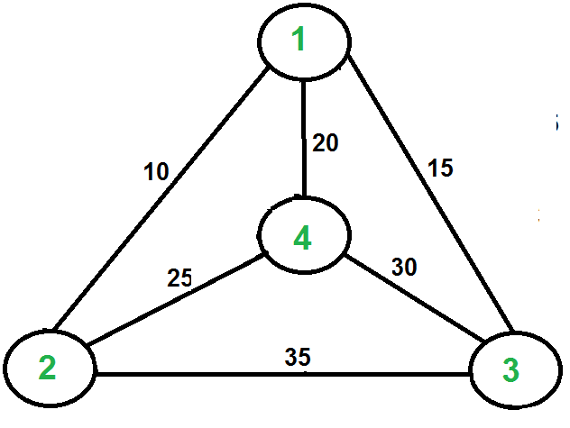
Travelling Salesman Problem (TSP)
Given a set of cities and distance between every pair of cities, the problem is to find the shortest possible route that visits every city exactly once and returns to the starting point.
For example, consider the graph shown in figure on right side. A TSP tour in the graph is 1-2-4-3-1. The cost of the tour is 10+25+30+15 which is 80.
The problem is a famous NP hard problem.
There is no polynomial time solution for this
problem.
Complexity using Brute Force – θ(n!)
Complexity using DP – O(n²2^{n}) – exponential
Complexity using Branch and Bound – O(n!),
but in best case works better

Slide 17
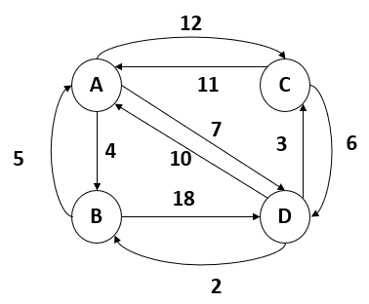
Example 1
Solve the given TSP using Branch and Bound
Solution:
Step 1: Write the initial cost matrix and reduce it
Step 2: Select the best vertex where we can land upon to minimize the tour cost
Step 3: Expand the selected vertex and repeat step 1 till the end point is reached

Slide 18
Example 1: TSP
Step 1: Write the initial cost matrix and reduce it
For reduction, do the following:
Reduce by row and reduce by column
Subtract each row and column by the minimum entry in that row/column
If a particular row or a column has a zero (0) then that row/column need not be reduced (i.e.) it is already in the reduced form
Initial Cost Matrix
 | A | B | C | D
A | ∞ | 4 | 12 | 7
B | 5 | ∞ | ∞ | 18
C | 11 | ∞ | ∞ | 6
D | 10 | 2 | 3 | ∞

Slide 19
Example 1: TSP -- contd
Reduce by row
 | A | B | C | D
A | ∞ | 0 | 8 | 3
B | 0 | ∞ | ∞ | 13
C | 5 | ∞ | ∞ | 0
D | 8 | 0 | 1 | ∞
Min | -- | -- | 1 | --
 | A | B | C | D | Min
A | ∞ | 4 | 12 | 7 | 4
B | 5 | ∞ | ∞ | 18 | 5
C | 11 | ∞ | ∞ | 6 | 6
D | 10 | 2 | 3 | ∞ | 2
Reduce by column
Cost of Node 1 (Initial Node) = Previous node Cost + Min of
Row + Min of Col = 0 + 4+5+6+2+1 = 18
 | A | B | C | D
A | ∞ | 0 | 7 | 3
B | 0 | ∞ | ∞ | 13
C | 5 | ∞ | ∞ | 0
D | 8 | 0 | 0 | ∞

Slide 20
Example 1: TSP -- contd
A
Cost of node 1 = 18
State space tree
Name the nodes with unique numbers as and when explored (i.e.) root A will be called as node 1
We have the cost of the first node 1 computed in the previous step as 18
Now proceed with the next level construction in the tree
Explore the possibilities or options for the salesman to travel
Find the cost of all the possibilities from the previously reduced matrix
Choose the node with the minimum cost to explore further and repeat the steps
node 2
node 3
node 4
B
C
D
To start with the next step:
Explore the next possible node, say A--B in the tree
Consider the matrix obtained in the step 1 and note the value of matrix[A,B] which is 0 (Zero) for further computation
Set entire Row A and Column B to ∞
Set matrix[B,A] to ∞
Now write the new cost matrix with these updates
Go with row reduction and column reduction mentioned in the previous slide and compute the cost of the node
Now repeat these steps for the next possible nodes and choose the node with minimum cost for the next level

Slide 21
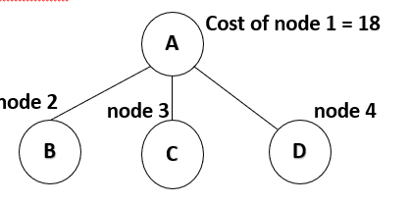
Example 1: TSP -- contd
Reduce by row
Now exploring A—B path
The cost matrix of node A becomes…
 | A | B | C | D
A | ∞ | ∞ | ∞ | ∞
B | ∞ | ∞ | ∞ | 0
C | 5 | ∞ | ∞ | 0
D | 8 | ∞ | 0 | ∞
Min | 5 | -- | -- | --
 | A | B | C | D
A | ∞ | 0 | 7 | 3
B | 0 | ∞ | ∞ | 13
C | 5 | ∞ | ∞ | 0
D | 8 | 0 | 0 | ∞
 | A | B | C | D | Min
A | ∞ | ∞ | ∞ | ∞ | --
B | ∞ | ∞ | ∞ | 13 | 13
C | 5 | ∞ | ∞ | 0 | --
D | 8 | ∞ | 0 | ∞ | --
 | A | B | C | D
A | ∞ | ∞ | ∞ | ∞
B | ∞ | ∞ | ∞ | 0
C | 0 | ∞ | ∞ | 0
D | 3 | ∞ | 0 | ∞
Cost of Node 2= Previous node Cost + Min of Row + Min of Col + cost of current link (i.e.) matrix[A,B]
= 18 + 13 + 5 + 0 = 36
Reduce by column

Slide 22
Example 1: TSP -- contd
Reduce by row
Now exploring A—C path
The cost matrix of node A becomes…
 | A | B | C | D
A | ∞ | ∞ | ∞ | ∞
B | 0 | ∞ | ∞ | 13
C | ∞ | ∞ | ∞ | 0
D | 8 | 0 | ∞ | ∞
Min | -- | -- | -- | --
 | A | B | C | D
A | ∞ | 0 | 7 | 3
B | 0 | ∞ | ∞ | 13
C | 5 | ∞ | ∞ | 0
D | 8 | 0 | 0 | ∞
 | A | B | C | D | Min
A | ∞ | ∞ | ∞ | ∞ | --
B | 0 | ∞ | ∞ | 13 | --
C | ∞ | ∞ | ∞ | 0 | --
D | 8 | 0 | ∞ | ∞ | --
 | A | B | C | D
A | ∞ | ∞ | ∞ | ∞
B | 0 | ∞ | ∞ | 13
C | ∞ | ∞ | ∞ | 0
D | 8 | 0 | ∞ | ∞
Cost of Node 3= Previous node Cost + Min of Row + Min of Col + cost of current link (i.e.) matrix[A,C]
= 18 + 0 + 0 + 7 = 25
Reduce by column

Slide 23
Example 1: TSP -- contd
Reduce by row
Now exploring A—D path
The cost matrix of node A becomes…
 | A | B | C | D
A | ∞ | ∞ | ∞ | ∞
B | 0 | ∞ | ∞ | ∞
C | 0 | ∞ | ∞ | ∞
D | ∞ | 0 | 0 | ∞
 | -- | -- | -- | --
 | A | B | C | D
A | ∞ | 0 | 7 | 3
B | 0 | ∞ | ∞ | 13
C | 5 | ∞ | ∞ | 0
D | 8 | 0 | 0 | ∞
 | A | B | C | D | Min
A | ∞ | ∞ | ∞ | ∞ | --
B | 0 | ∞ | ∞ | ∞ | --
C | 5 | ∞ | ∞ | ∞ | 5
D | ∞ | 0 | 0 | ∞ | --
 | A | B | C | D
A | ∞ | ∞ | ∞ | ∞
B | 0 | ∞ | ∞ | ∞
C | 0 | ∞ | ∞ | ∞
D | ∞ | 0 | 0 | ∞
Cost of Node 4= Previous node Cost + Min of Row + Min of Col + cost of current link (i.e.) matrix[A,D]
= 18 + 5 + 0 + 3 = 26
Reduce by column

Slide 24
Example 1: TSP -- contd
A
Cost of node 1 = 18
Cost of node 2 = 36
Cost of node 4 = 26
B
C
D
From the resultant tree choose the lowest cost node for the next level of exploration and proceed with the further remaining options for the salesman to explore
In this case, explore node 3 and find the cost of each node in the next level
Repeat the previous steps
Cost of node 3 = 25
node 5
node 6
B
D

Slide 25
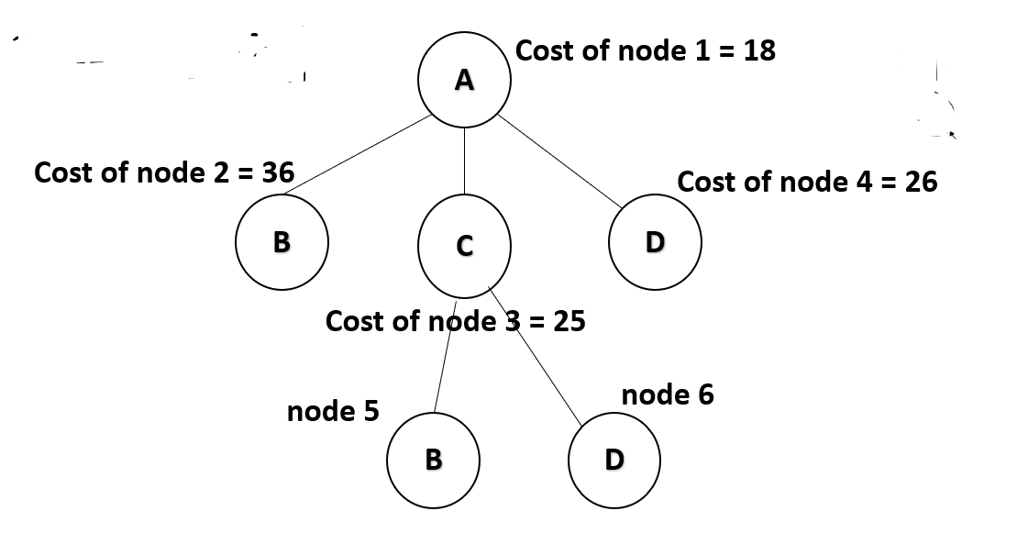

Example 1: TSP -- contd
Reduce by row
Now exploring A—C—B path
The cost matrix of node C becomes…
Make mat[B, A] =$∞$
 | A | B | C | D
A | ∞ | ∞ | ∞ | ∞
B | ∞ | ∞ | ∞ | 0
C | ∞ | ∞ | ∞ | ∞
D | 0 | ∞ | ∞ | ∞
Min | -- | -- | -- | --
 | A | B | C | D
A | ∞ | ∞ | ∞ | ∞
B | 0 | ∞ | ∞ | 13
C | ∞ | ∞ | ∞ | 0
D | 8 | 0 | ∞ | ∞
 | A | B | C | D | Min
A | ∞ | ∞ | ∞ | ∞ | --
B | ∞ | ∞ | ∞ | 13 | 13
C | ∞ | ∞ | ∞ | ∞ | --
D | 8 | ∞ | ∞ | ∞ | 8
 | A | B | C | D
A | ∞ | ∞ | ∞ | ∞
B | ∞ | ∞ | ∞ | 0
C | ∞ | ∞ | ∞ | ∞
D | 0 | ∞ | ∞ | ∞
Cost of Node 5= Previous node Cost + Min of Row + Min of Col + cost of current link (i.e.) matrix[C,B]
= 25 + 8 + 13 + ∞ = ∞
Reduce by column

Slide 26
Example 1: TSP -- contd
Reduce by row
Now exploring A — C—D path
The cost matrix of node C becomes…
 | A | B | C | D
A | ∞ | ∞ | ∞ | ∞
B | 0 | ∞ | ∞ | ∞
C | ∞ | ∞ | ∞ | ∞
D | ∞ | 0 | ∞ | ∞
Min | -- | -- | -- | --
 | A | B | C | D
A | ∞ | ∞ | ∞ | ∞
B | 0 | ∞ | ∞ | 13
C | ∞ | ∞ | ∞ | 0
D | 8 | 0 | ∞ | ∞
 | A | B | C | D | Min
A | ∞ | ∞ | ∞ | ∞ | --
B | 0 | ∞ | ∞ | ∞ | --
C | ∞ | ∞ | ∞ | ∞ | --
D | ∞ | 0 | ∞ | ∞ | --
 | A | B | C | D
A | ∞ | ∞ | ∞ | ∞
B | 0 | ∞ | ∞ | ∞
C | ∞ | ∞ | ∞ | ∞
D | ∞ | 0 | ∞ | ∞
Cost of Node 6= Previous node Cost + Min of Row + Min of Col + cost of current link (i.e.) matrix[C,D]
= 25 + 0 + 0 + 0 = 25
Reduce by column

Slide 27
Example 1: TSP -- contd
A
Cost of node 1 = 18
Cost of node 2 = 36
Cost of node 4 = 26
B
C
D
From the resultant tree choose the lowest cost node for the next level of exploration and proceed with the further remaining options for the salesman to explore
In this case, explore node 6 and find the cost of each node in the next level
Repeat the previous steps
Cost of node 3 = 25
B
D
Cost of node 6 = 25
Cost of node 5 = ∞
B
node 7

Slide 28
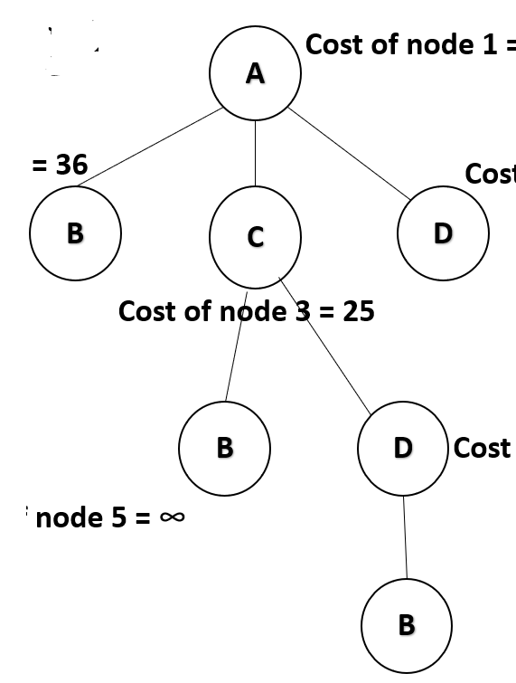
Example 1: TSP -- contd
Reduce by row
Now exploring A — C—D —B path
The cost matrix of node D becomes…
 | A | B | C | D
A | ∞ | ∞ | ∞ | ∞
B | ∞ | ∞ | ∞ | ∞
C | ∞ | ∞ | ∞ | ∞
D | ∞ | ∞ | ∞ | ∞
Min | -- | -- | -- | --
 | A | B | C | D
A | ∞ | ∞ | ∞ | ∞
B | 0 | ∞ | ∞ | ∞
C | ∞ | ∞ | ∞ | ∞
D | ∞ | 0 | ∞ | ∞
 | A | B | C | D | Min
A | ∞ | ∞ | ∞ | ∞ | --
B | ∞ | ∞ | ∞ | ∞ | --
C | ∞ | ∞ | ∞ | ∞ | --
D | ∞ | ∞ | ∞ | ∞ | --
 | A | B | C | D
A | ∞ | ∞ | ∞ | ∞
B | ∞ | ∞ | ∞ | ∞
C | ∞ | ∞ | ∞ | ∞
D | ∞ | ∞ | ∞ | ∞
Cost of Node 7= Previous node Cost + Min of Row + Min of Col + cost of current link (i.e.) matrix[D,B]
= 25 + 0 + 0 + 0 = 25
Reduce by column
Node is completely reduced… , reached terminal condition

Slide 29
Example 1: TSP -- contd
A
Cost of node 1 = 18
Cost of node 2 = 36
Cost of node 4 = 26
Final Solution (Path) is
A – C – D – B – A
with minimum cost as 25
B
C
D
Cost of node 3 = 25
Cost of node 6 = 25
B
D
Cost of node 5 = ∞
B
Cost of node 7 = 25

Slide 30
Example 2: Solve the given TSP
Step 1: Write the initial cost matrix and reduce it
For reduction, do the following:
Reduce by row and reduce by column
Subtract each row and column by the minimum entry in that row/column
If a particular row or a column has a zero (0) then that row/column need not be reduced
Initial Cost Matrix
A
 | A | B | C | D
A | ∞ | 10 | 15 | 20
B | 10 | ∞ | 35 | 25
C | 15 | 35 | ∞ | 30
D | 20 | 25 | 30 | ∞
D
B
C

Slide 31
Example 2: TSP -- contd
Reduce by row
 | A | B | C | D
A | ∞ | 0 | 5 | 10
B | 0 | ∞ | 25 | 15
C | 0 | 20 | ∞ | 15
D | 0 | 5 | 10 | ∞
Min | -- | -- | 5 | 10
 | A | B | C | D | Min
A | ∞ | 10 | 15 | 20 | 10
B | 10 | ∞ | 35 | 25 | 10
C | 15 | 35 | ∞ | 30 | 15
D | 20 | 25 | 30 | ∞ | 20
Reduce by column
Cost of Node 1 (Initial Node) = Previous node Cost + Min of
Row + Min of Col = 0 + 55 + 15 = 70
 | A | B | C | D
A | ∞ | 0 | 0 | 0
B | 0 | ∞ | 20 | 5
C | 0 | 20 | ∞ | 5
D | 0 | 5 | 5 | ∞

Slide 32
Example 2: TSP -- contd
A
D
A
Cost of node 1 = 70
State space tree
Name the nodes with unique numbers as and when explored (i.e.) root A will be called as node 1
We have the cost of the first node 1 computed in the previous step as 70
Now proceed with the next level construction in the tree
Explore the possibilities or options for the salesman to travel
Find the cost of all the possibilities from the previously reduced matrix
Choose the node with the minimum cost to explore further and repeat the steps
B
C
node 2
node 3
node 4
B
C
D
To start with the next step:
Explore the next possible node, say A--B in the tree
Consider the matrix obtained in the step 1 and note the value of matrix[A,B] which is 0 (Zero) for further computation
Set entire Row A and Column B to ∞
Set matrix[B,A] to ∞
Now write the new cost matrix with these updates
Go with row reduction and column reduction mentioned in the previous slide and compute the cost of the node
Now repeat these steps for the next possible nodes and choose the node with minimum cost for the next level

Slide 33
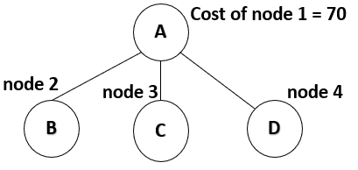
Example 2 : TSP -- contd
Reduce by row
Now exploring A—B path
The cost matrix of node A becomes…
 | A | B | C | D
A | ∞ | ∞ | ∞ | ∞
B | ∞ | ∞ | 15 | 0
C | 0 | ∞ | ∞ | 5
D | 0 | ∞ | 5 | ∞
Min | -- | -- | 5 | --
 | A | B | C | D
A | ∞ | 0 | 0 | 0
B | 0 | ∞ | 20 | 5
C | 0 | 20 | ∞ | 5
D | 0 | 5 | 5 | ∞
 | A | B | C | D | Min
A | ∞ | ∞ | ∞ | ∞ | --
B | ∞ | ∞ | 20 | 5 | 5
C | 0 | ∞ | ∞ | 5 | --
D | 0 | ∞ | 5 | ∞ | --
 | A | B | C | D
A | ∞ | ∞ | ∞ | ∞
B | ∞ | ∞ | 10 | 0
C | 0 | ∞ | ∞ | 5
D | 0 | ∞ | 0 | ∞
Cost of Node 2= Previous node Cost + Min of Row + Min of Col + cost of current link (i.e.) matrix[A,B]
= 70 + 5 + 5 + 0 = 80
Reduce by column

Slide 34
Example 2 : TSP -- contd
Reduce by row
Now exploring A—C path
The cost matrix of node A becomes…
 | A | B | C | D
A | ∞ | ∞ | ∞ | ∞
B | 0 | ∞ | ∞ | 5
C | ∞ | 15 | ∞ | 0
D | 0 | 5 | ∞ | ∞
Min | -- | 5 | -- | --
 | A | B | C | D
A | ∞ | 0 | 0 | 0
B | 0 | ∞ | 20 | 5
C | 0 | 20 | ∞ | 5
D | 0 | 5 | 5 | ∞
 | A | B | C | D | Min
A | ∞ | ∞ | ∞ | ∞ | --
B | 0 | ∞ | ∞ | 5 | --
C | ∞ | 20 | ∞ | 5 | 5
D | 0 | 5 | ∞ | ∞ | --
 | A | B | C | D
A | ∞ | ∞ | ∞ | ∞
B | 0 | ∞ | ∞ | 5
C | ∞ | 10 | ∞ | 0
D | 0 | 0 | ∞ | ∞
Cost of Node 3= Previous node Cost + Min of Row + Min of Col + cost of current link (i.e.) matrix[A,C]
= 70 + 5 + 5 + 0 = 80
Reduce by column

Slide 35
Example 2 : TSP -- contd
Reduce by row
Now exploring A—D path
The cost matrix of node A becomes…
 | A | B | C | D
A | ∞ | ∞ | ∞ | ∞
B | 0 | ∞ | 20 | ∞
C | 0 | 20 | ∞ | ∞
D | ∞ | 0 | 0 | ∞
 | -- | -- | -- | --
 | A | B | C | D
A | ∞ | 0 | 0 | 0
B | 0 | ∞ | 20 | 5
C | 0 | 20 | ∞ | 5
D | 0 | 5 | 5 | ∞
 | A | B | C | D | Min
A | ∞ | ∞ | ∞ | ∞ | --
B | 0 | ∞ | 20 | ∞ | --
C | 0 | 20 | ∞ | ∞ | --
D | ∞ | 5 | 5 | ∞ | 5
 | A | B | C | D
A | ∞ | ∞ | ∞ | ∞
B | 0 | ∞ | 20 | ∞
C | 0 | 20 | ∞ | ∞
D | ∞ | 0 | 0 | ∞
Cost of Node 4= Previous node Cost + Min of Row + Min of Col + cost of current link (i.e.) matrix[A,D]
= 70 + 5 + 0 + 0 =75
Reduce by column

Slide 36
Example 2 : TSP -- contd
A
70
A
Cost of node 1 = 18
D
B
C
Cost of node 2 = 80
Cost of node 4 = 75
B
C
D
From the resultant tree choose the lowest cost node for the next level of exploration and proceed with the further remaining options for the salesman to explore
In this case, explore node 4 and find the cost of each node in the next level
Repeat the previous steps
Cost of node 3 = 80
node 5
node 6
B
C

Slide 37
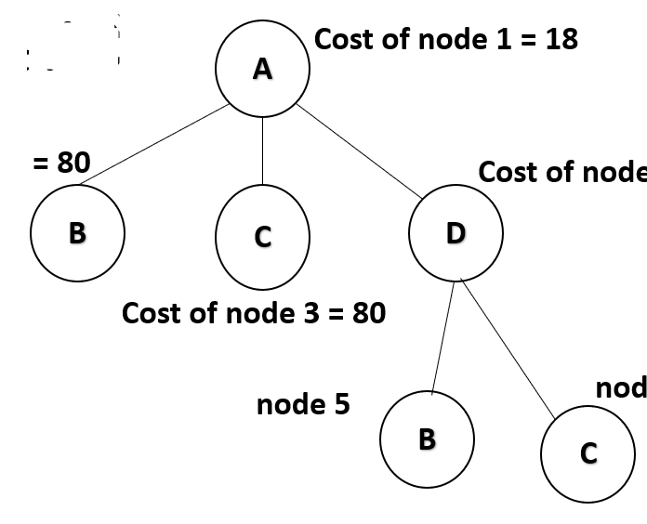
Example 2 : TSP -- contd
70
Reduce by row
Now exploring A—D—B path
The cost matrix of node D becomes…
 | A | B | C | D
A | ∞ | ∞ | ∞ | ∞
B | ∞ | ∞ | 0 | ∞
C | 0 | ∞ | ∞ | ∞
D | ∞ | ∞ | ∞ | ∞
Min | -- | -- | -- | --
 | A | B | C | D
A | ∞ | ∞ | ∞ | ∞
B | 0 | ∞ | 20 | ∞
C | 0 | 20 | ∞ | ∞
D | ∞ | 0 | 0 | ∞
 | A | B | C | D | Min
A | ∞ | ∞ | ∞ | ∞ | --
B | ∞ | ∞ | 20 | ∞ | 20
C | 0 | ∞ | ∞ | ∞ | --
D | ∞ | ∞ | ∞ | ∞ | --
 | A | B | C | D
A | ∞ | ∞ | ∞ | ∞
B | ∞ | ∞ | 0 | ∞
C | 0 | ∞ | ∞ | ∞
D | ∞ | ∞ | ∞ | ∞
Cost of Node 5= Previous node Cost + Min of Row + Min of Col + cost of current link (i.e.) matrix[D,B]
= 75 + 20 + 0 + 0 = 95
Reduce by column

Slide 38
Example 2 : TSP -- contd
70
Reduce by row
Now exploring A — D—C path
The cost matrix of node D becomes…
 | A | B | C | D
A | ∞ | ∞ | ∞ | ∞
B | 0 | ∞ | ∞ | ∞
C | ∞ | 0 | ∞ | ∞
D | ∞ | ∞ | ∞ | ∞
Min | -- | -- | -- | --
 | A | B | C | D
A | ∞ | ∞ | ∞ | ∞
B | 0 | ∞ | 20 | ∞
C | 0 | 20 | ∞ | ∞
D | ∞ | 0 | 0 | ∞
 | A | B | C | D | Min
A | ∞ | ∞ | ∞ | ∞ | --
B | 0 | ∞ | ∞ | ∞ | --
C | ∞ | 20 | ∞ | ∞ | 20
D | ∞ | ∞ | ∞ | ∞ | --
 | A | B | C | D
A | ∞ | ∞ | ∞ | ∞
B | 0 | ∞ | ∞ | ∞
C | ∞ | 0 | ∞ | ∞
D | ∞ | ∞ | ∞ | ∞
Cost of Node 6= Previous node Cost + Min of Row + Min of Col + cost of current link (i.e.) matrix[D,C]
= 75 + 20 + 0 + 0 = 95
Reduce by column

Slide 39
Example 2 : TSP -- contd
A
70
A
Cost of node 1 = 18
D
B
C
Cost of node 2 = 80
Cost of node 4 = 75
B
C
D
From the resultant tree choose the lowest cost node for the next level of exploration and proceed with the further remaining options for the salesman to explore
In this case, explore node 2 and find the cost of each node in the next level
Repeat the previous steps
Cost of node 3 = 80
C
D
B
C
Cost of node 6 = 95
node 7
node 8
Cost of node 5 = 95

Slide 40
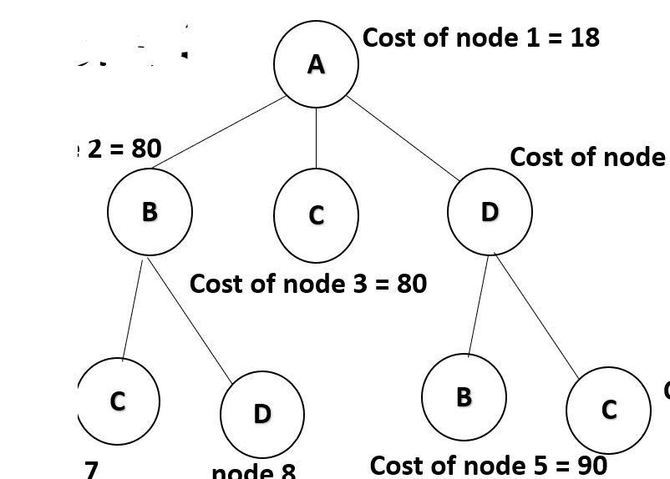
Example 2 : TSP -- contd
70
Reduce by row
Now exploring A—B—C path
The cost matrix of node B becomes…
 | A | B | C | D
A | ∞ | ∞ | ∞ | ∞
B | ∞ | ∞ | ∞ | ∞
C | ∞ | ∞ | ∞ | 0
D | 0 | ∞ | ∞ | ∞
Min | -- | -- | -- | --
 | A | B | C | D
A | ∞ | ∞ | ∞ | ∞
B | ∞ | ∞ | 10 | 0
C | 0 | ∞ | ∞ | 5
D | 0 | ∞ | 0 | ∞
 | A | B | C | D | Min
A | ∞ | ∞ | ∞ | ∞ | --
B | ∞ | ∞ | ∞ | ∞ | --
C | ∞ | ∞ | ∞ | 5 | 5
D | 0 | ∞ | ∞ | ∞ | --
 | A | B | C | D
A | ∞ | ∞ | ∞ | ∞
B | ∞ | ∞ | ∞ | ∞
C | ∞ | ∞ | ∞ | 0
D | 0 | ∞ | ∞ | ∞
Cost of Node 7= Previous node Cost + Min of Row + Min of Col + cost of current link (i.e.) matrix[B,C]
= 80 + 5 + 0 + 10 = 95
Reduce by column

Slide 41
Example 2 : TSP -- contd
70
Reduce by row
Now exploring A — B—D path
The cost matrix of node B becomes…
 | A | B | C | D
A | ∞ | ∞ | ∞ | ∞
B | ∞ | ∞ | ∞ | ∞
C | 0 | ∞ | ∞ | ∞
D | ∞ | ∞ | 0 | ∞
Min | -- | -- | -- | --
 | A | B | C | D
A | ∞ | ∞ | ∞ | ∞
B | ∞ | ∞ | 10 | 0
C | 0 | ∞ | ∞ | 5
D | 0 | ∞ | 0 | ∞
 | A | B | C | D | Min
A | ∞ | ∞ | ∞ | ∞ | --
B | ∞ | ∞ | ∞ | ∞ | --
C | 0 | ∞ | ∞ | ∞ | --
D | ∞ | ∞ | 0 | ∞ | --
 | A | B | C | D
A | ∞ | ∞ | ∞ | ∞
B | ∞ | ∞ | ∞ | ∞
C | 0 | ∞ | ∞ | ∞
D | ∞ | ∞ | 0 | ∞
Cost of Node 8= Previous node Cost + Min of Row + Min of Col + cost of current link (i.e.) matrix[B,D]
= 80 + 0 + 0 + 0 = 80
Reduce by column

Slide 42
Example 2 : TSP -- contd
A
70
A
Cost of node 1 = 18
D
B
C
Cost of node 2 = 80
Cost of node 4 = 75
B
C
D
From the resultant tree choose the lowest cost node for the next level of exploration and proceed with the further remaining options for the salesman to explore
In this case, explore node 8 and find the cost of each node in the next level
Repeat the previous steps
Cost of node 3 = 80
Cost of node 7 = 95
Cost of node 5 = 95
C
D
B
C
Cost of node 6 = 95
Cost of node 8 = 80
C
node 9

Slide 43
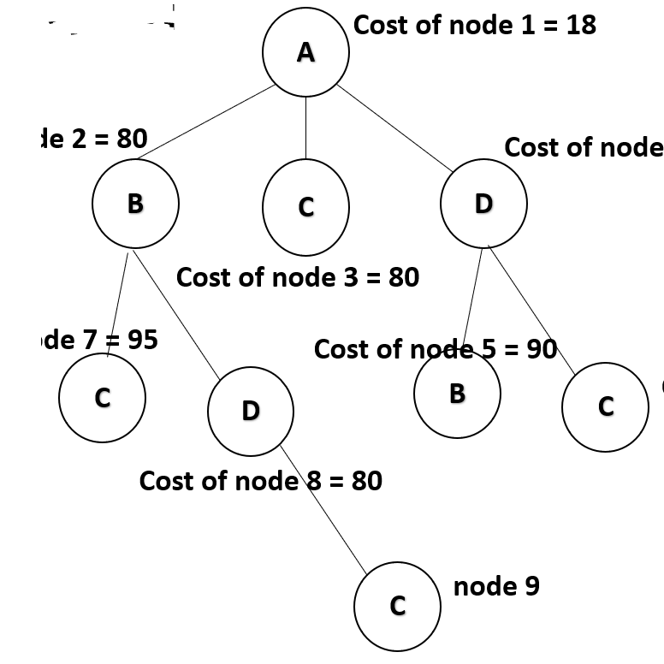
Example 2 : TSP -- contd
70
Reduce by row
Now exploring A — B—D —C path
The cost matrix of node D becomes…
 | A | B | C | D
A | ∞ | ∞ | ∞ | ∞
B | ∞ | ∞ | ∞ | ∞
C | ∞ | ∞ | ∞ | ∞
D | ∞ | ∞ | ∞ | ∞
Min | -- | -- | -- | --
 | A | B | C | D
A | ∞ | ∞ | ∞ | ∞
B | ∞ | ∞ | ∞ | ∞
C | 0 | ∞ | ∞ | ∞
D | ∞ | ∞ | 0 | ∞
 | A | B | C | D | Min
A | ∞ | ∞ | ∞ | ∞ | --
B | ∞ | ∞ | ∞ | ∞ | --
C | ∞ | ∞ | ∞ | ∞ | --
D | ∞ | ∞ | ∞ | ∞ | --
 | A | B | C | D
A | ∞ | ∞ | ∞ | ∞
B | ∞ | ∞ | ∞ | ∞
C | ∞ | ∞ | ∞ | ∞
D | ∞ | ∞ | ∞ | ∞
Cost of Node 9= Previous node Cost + Min of Row + Min of Col + cost of current link (i.e.) matrix[D,C]
= 80 + 0 + 0 + 0 = 80
Reduce by column
Node is completely reduced… , reached terminal condition

Slide 44
Example 2 : TSP -- contd
70
A
Cost of node 1 = 18
Cost of node 2 = 80
Cost of node 4 = 75
Final Solution (Path) is
A – B – D – C – A
with minimum cost as 80
A
B
C
D
Cost of node 3 = 80
D
Cost of node 7 = 95
Cost of node 5 = 95
C
D
B
C
Cost of node 6 = 95
B
C
Cost of node 8 = 80
C
Cost of node 9 = 80

Slide 45
Complexity of Branch and Bound
These problems are typically exponential in terms of time complexity and may require exploring all possible permutations in worst case.
But, Branch and Bound solve the problems relatively quickly (best case and average case).

Slide 46
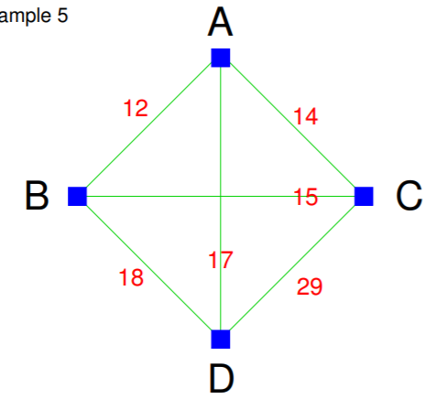
Exercise Problem
Solve the TSP given using Branch and Bound

